Slide 1
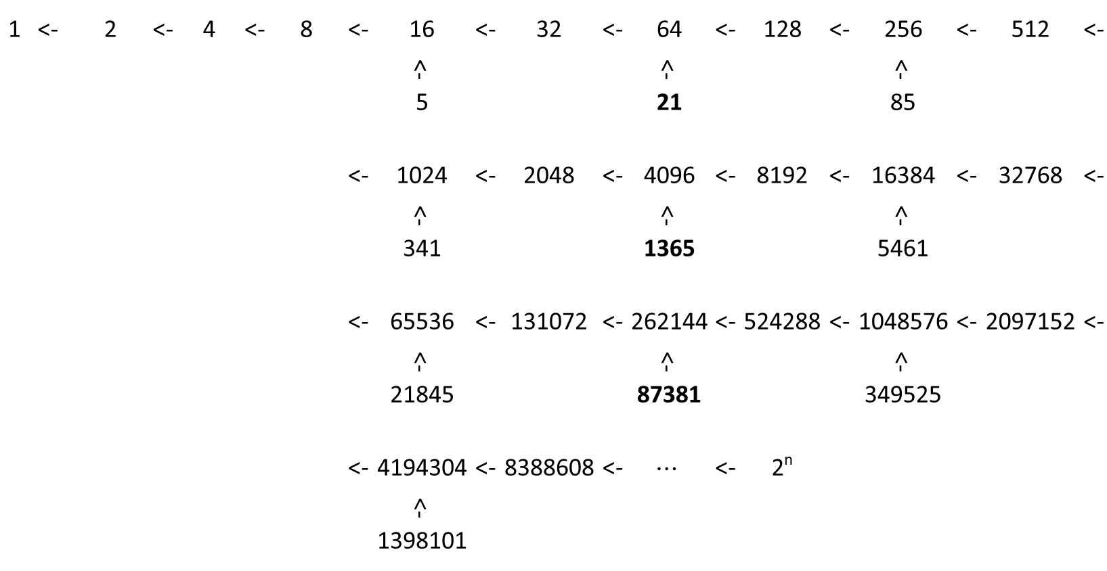
1 | <- | 2 | <- | 4 | <- | 8 | <- | 16 | <- | 32 | <- | 64 | <- | 128 | <- | 256 | <- | 512 | <-
 |  |  |  |  |  |  |  | <- |  |  |  | <- |  |  |  | <-
 |  |  |  |  |  |  |  | 5 |  |  |  | 21 |  |  |  | 85
 |  |  |  |  |  |  | <- | 1024 | <- | 2048 | <- | 4096 | <- | 8192 | <- | 16384 | <- | 32768 | <-
 |  |  |  |  |  |  |  | <- |  |  |  | <- |  |  |  | <-
 |  |  |  |  |  |  |  | 341 |  |  |  | 1365 |  |  |  | 5461
 |  |  |  |  |  |  | <- | 65536 | <- | 131072 | <- | 262144 | <- | 524288 | <- | 1048576 | <- | 2097152 | <-
 |  |  |  |  |  |  |  | <- |  |  |  | <- |  |  |  | <-
 |  |  |  |  |  |  |  | 21845 |  |  |  | 87381 |  |  |  | 349525
 |  |  |  |  |  |  | <- | 4194304 | <- | 8388608 | <- | $$⋯$$ | <- | 2^{n}
 |  |  |  |  |  |  |  | <-
 |  |  |  |  |  |  |  | 1398101

Slide 2
Base Stem
1
<- |  |  |  |  |  |  |  |  |  |  |  | n | Base Stem Values
2 |  |  |  |  |  |  |  |  |  |  |  | n | Node Values / Nodes
<- |  |  |  |  |  |  |  |  |  |  |  | n | Branch Values
4 |  |  |  |  |  |  |  |  |  |  |  | n | Nodes with No Branching
<-
8
<-
16 | <- | 5 | <- | 10 | <- | 20 | <- | 40 | <- | 80 | <- | 160 | <- | 320 | <- | 640 | <- | 1280 | <- | 2560 | <- | 5120 | <- | 10240 | <- | 20480 |  | Branch Values
<- |  |  |  | <- |  |  |  | <- |  |  |  | <- |  |  |  | <- |  |  |  | <- |  |  |  | <-
32 |  |  |  | 3 |  |  |  | 13 |  |  |  | 53 |  |  |  | 213 |  |  |  | 853 |  |  |  | 3413
<-
64 | <- | 21 | <- | 42 | <- | 84 | <- | 168 | <- | 336 | <- | 672 | <- | 1344 | <- | 2688 | <- | 5376 | <- | 10752 | <- | 21504 | <- | 43008 | <- | 86016
<-
128
<-
256 | <- | 85 | <- | 170 | <- | 340 | <- | 680 | <- | 1360 | <- | 2720 | <- | 5440 | <- | 10880 | <- | 21760 | <- | 43520 | <- | 87040 | <- | 174080 | <- | 348160
<- |  |  |  |  |  | <- |  |  |  | <- |  |  |  | <- |  |  |  | <- |  |  |  | <- |  |  |  | <-
512 |  | Nodes |  |  |  | 113 |  |  |  | 453 |  |  |  | 1813 |  |  |  | 7253 |  |  |  | 29013 |  |  |  | 116053
<-
1024 | <- | 341 | <- | 682 | <- | 1364 | <- | 2728 | <- | 5456 | <- | 10912 | <- | 21824 | <- | 43648 | <- | 87296 | <- | 174592 | <- | 349184 | <- | 698368 | <- | 1396736
<- |  |  |  | <- |  |  |  | <- |  |  |  | <- |  |  |  | <- |  |  |  | <- |  |  |  | <-
2048 |  |  |  | 227 |  |  |  | 909 |  |  |  | 3637 |  |  |  | 14549 |  |  |  | 58197 |  |  |  | 232789
<-
4096 | <- | 1365 | <- | 2730 | <- | 5460 | <- | 10920 | <- | 21840 | <- | 43680 | <- | 87360 | <- | 174720 | <- | 349440 | <- | 698880 | <- | 1397760 | <- | 2795520 | <- | 5591040
<-
8192
<-
16384 | <- | 5461 | <- | 10922 | <- | 21844 | <- | 43688 | <- | 87376 | <- | 174752 | <- | 349504 | <- | 699008 | <- | 1398016 | <- | 2796032 | <- | 5592064 | <- | 11184128 | <- | 22368256
<- |  |  |  |  |  | <- |  |  |  | <- |  |  |  | <- |  |  |  | <- |  |  |  | <- |  |  |  | <-
32768 |  |  |  |  |  | 7281 |  |  |  | 29125 |  |  |  | 116501 |  |  |  | 466005 |  |  |  | 1864021 |  |  |  | 7456085
<-

Slide 3
Base Stem |  |  |  |  |  |  |  |  |  | n | Base Stem Values
 |  |  |  |  |  |  |  |  |  | n | Node Values / Nodes
1 |  |  |  |  |  |  |  |  |  | n | Branch Values
<- |  |  |  |  |  |  |  |  |  | n | Nodes with No Branching
2
<-
4
<-
8
<-
16 | <- | 5 | <- | 10 | <- | 20 | <- | 40 | <- | 80 | <- | 160 | <- | 320 | <- | 640 | <- | 1280 | <- | 2560 | <- | 5120 | <- | 10240 | <- | 20480 | <- | Branch
<- |  |  |  | <- |  |  |  | <- |  |  |  | <- |  |  |  | <- |  |  |  | <- |  |  |  | <-
32 |  |  |  | 3 |  |  |  | 13 |  |  |  | 53 |  |  |  | 213 |  |  |  | 853 |  |  |  | 3413
<-
64 | <- | 21 | <- | 42 | <- | 84 | <- | 168 | <- | 336 | <- | 672 | <- | 1344 | <- | 2688 | <- | 5376 | <- | 10752 | <- | 21504 | <- | 43008 | <- | 86016 | <-
<-
128
<-
256 | <- | 85 | <- | 170 | <- | 340 | <- | 680 | <- | 1360 | <- | 2720 | <- | 5440 | <- | 10880 | <- | 21760 | <- | 43520 | <- | 87040 | <- | 174080 | <- | 348160 | <-
<- |  |  |  |  |  | <- |  |  |  | <- |  |  |  | <- |  |  |  | <- |  |  |  | <- |  |  |  | <-
512 |  | Nodes |  |  |  | 113 |  |  |  | 453 |  |  |  | 1813 |  |  |  | 7253 |  |  |  | 29013 |  |  |  | 116053
<-
1024 | <- | 341 | <- | 682 | <- | 1364 | <- | 2728 | <- | 5456 | <- | 10912 | <- | 21824 | <- | 43648 | <- | 87296 | <- | 174592 | <- | 349184 | <- | 698368 | <- | 1396736 | <-
<- |  |  |  | <- |  |  |  | <- |  |  |  | <- |  |  |  | <- |  |  |  | <- |  |  |  | <-
2048 |  |  |  | 227 |  |  |  | 909 |  |  |  | 3637 |  |  |  | 14549 |  |  |  | 58197 |  |  |  | 232789
<-
4096 | <- | 1365 | <- | 2730 | <- | 5460 | <- | 10920 | <- | 21840 | <- | 43680 | <- | 87360 | <- | 174720 | <- | 349440 | <- | 698880 | <- | 1397760 | <- | 2795520 | <- | 5591040 | <-
<-
8192
<-
16384 | <- | 5461 | <- | 10922 | <- | 21844 | <- | 43688 | <- | 87376 | <- | 174752 | <- | 349504 | <- | 699008 | <- | 1398016 | <- | 2796032 | <- | 5592064 | <- | 11184128 | <- | 22368256 | <-
<- |  |  |  |  |  | <- |  |  |  | <- |  |  |  | <- |  |  |  | <- |  |  |  | <- |  |  |  | <-
32768 |  |  |  |  |  | 7281 |  |  |  | 29125 |  |  |  | 116501 |  |  |  | 466005 |  |  |  | 1864021 |  |  |  | 7456085
<-

Slide 4
 |  |  |  | 1 |  | 2 |  | 3 |  | 4 |  | 5 |  | 6 |  | 7 |  | 8 |  | 9 |  | 10 |  | 11 |  | 12
8
<-
16 | <- | 5 | <- | 10 | <- | 20 | <- | 40 | <- | 80 | <- | 160 | <- | 320 | <- | 640 | <- | 1280 | <- | 2560 | <- | 5120 | <- | 10240 | <- | 20480 | <-
<- |  |  |  | <- |  |  |  | <- |  |  |  | <- |  |  |  | <- |  |  |  | <- |  |  |  | <-
32 |  |  |  | 3 |  |  |  | 13 |  |  |  | 53 |  |  |  | 213 |  |  |  | 853 |  |  |  | 3413
<-
64 | <- | 21 | <- | 42 | <- | 84 | <- | 168 | <- | 336 | <- | 672 | <- | 1344 | <- | 2688 | <- | 5376 | <- | 10752 | <- | 21504 | <- | 43008 | <- | 86016 | <-
<-
128
<-
256 | <- | 85 | <- | 170 | <- | 340 | <- | 680 | <- | 1360 | <- | 2720 | <- | 5440 | <- | 10880 | <- | 21760 | <- | 43520 | <- | 87040 | <- | 174080 | <- | 348160 | <-
<- |  |  |  |  |  | <- |  |  |  | <- |  |  |  | <- |  |  |  | <- |  |  |  | <- |  |  |  | <-
512 |  |  |  |  |  | 113 |  |  |  | 453 |  |  |  | 1813 |  |  |  | 7253 |  |  |  | 29013 |  |  |  | 116053
<-
1024 | <- | 341 | <- | 682 | <- | 1364 | <- | 2728 | <- | 5456 | <- | 10912 | <- | 21824 | <- | 43648 | <- | 87296 | <- | 174592 | <- | 349184 | <- | 698368 | <- | 1396736 | <-
<- |  |  |  | <- |  |  |  | <- |  |  |  | <- |  |  |  | <- |  |  |  | <- |  |  |  | <-
2048 |  |  |  | 227 |  |  |  | 909 |  |  |  | 3637 |  |  |  | 14549 |  |  |  | 58197 |  |  |  | 232789
<-
4096 | <- | 1365 | <- | 2730 | <- | 5460 | <- | 10920 | <- | 21840 | <- | 43680 | <- | 87360 | <- | 174720 | <- | 349440 | <- | 698880 | <- | 1397760 | <- | 2795520 | <- | 5591040 | <-
<-
8192
<-
16384 | <- | 5461 | <- | 10922 | <- | 21844 | <- | 43688 | <- | 87376 | <- | 174752 | <- | 349504 | <- | 699008 | <- | 1398016 | <- | 2796032 | <- | 5592064 | <- | 11184128 | <- | 22368256 | <-
<- |  |  |  |  |  | <- |  |  |  | <- |  |  |  | <- |  |  |  | <- |  |  |  | <- |  |  |  | <-
32768 |  |  |  |  |  | 7281 |  |  |  | 29125 |  |  |  | 116501 |  |  |  | 466005 |  |  |  | 1864021 |  |  |  | 7456085
<-

Slide 5
 |  |  |  | 1 |  | 2 |  | 3 |  | 4 |  | 5 |  | 6 |  | 7 |  | 8 |  | 9 |  | 10 |  | 11 |  | 12
5
<-
10 | <- | 3 | <- | 6 | <- | 12 | <- | 24 | <- | 48 | <- | 96 | <- | 192 | <- | 384 | <- | 768 | <- | 1536 | <- | 3072 | <- | 6144 | <- | 12288 | <-
<-
20
<-
40 | <- | 13 | <- | 26 | <- | 52 | <- | 104 | <- | 208 | <- | 416 | <- | 832 | <- | 1664 | <- | 3328 | <- | 6656 | <- | 13312 | <- | 26624 | <- | 53248 | <-
<- |  |  |  |  |  | <- |  |  |  | <- |  |  |  | <- |  |  |  | <- |  |  |  | <- |  |  |  | <-
80 |  |  |  |  |  | 17 |  |  |  | 69 |  |  |  | 277 |  |  |  | 1109 |  |  |  | 4437 |  |  |  | 17749
<-
160 | <- | 53 | <- | 106 | <- | 212 | <- | 424 | <- | 848 | <- | 1696 | <- | 3392 | <- | 6784 | <- | 13568 | <- | 27136 | <- | 54272 | <- | 108544 | <- | 217088 | <-
<- |  |  |  | <- |  |  |  | <- |  |  |  | <- |  |  |  | <- |  |  |  | <- |  |  |  | <-
320 |  |  |  | 35 |  |  |  | 141 |  |  |  | 565 |  |  |  | 2261 |  |  |  | 9045 |  |  |  | 36181
<-
640 | <- | 213 | <- | 426 | <- | 852 | <- | 1704 | <- | 3408 | <- | 6816 | <- | 13632 | <- | 27264 | <- | 54528 | <- | 109056 | <- | 218112 | <- | 436224 | <- | 872448 | <-
<-
1280
<-
2560 | <- | 853 | <- | 1706 | <- | 3412 | <- | 6824 | <- | 13648 | <- | 27296 | <- | 54592 | <- | 109184 | <- | 218368 | <- | 436736 | <- | 873472 | <- | 1746944 | <- | 3493888 | <-
<- |  |  |  |  |  | <- |  |  |  | <- |  |  |  | <- |  |  |  | <- |  |  |  | <- |  |  |  | <-
5120 |  |  |  |  |  | 1137 |  |  |  | 4549 |  |  |  | 18197 |  |  |  | 72789 |  |  |  | 291157 |  |  |  | 1164629
<-
10240 | <- | 3413 | <- | 6826 | <- | 13652 | <- | 27304 | <- | 54608 | <- | 109216 | <- | 218432 | <- | 436864 | <- | 873728 | <- | 1747456 | <- | 3494912 | <- | 6989824 | <- | 13979648 | <-
<- |  |  |  | <- |  |  |  | <- |  |  |  | <- |  |  |  | <- |  |  |  | <- |  |  |  | <-
20480 |  |  |  | 2275 |  |  |  | 9101 |  |  |  | 36405 |  |  |  | 145621 |  |  |  | 582485 |  |  |  | 2329941
<-

Slide 6
 |  |  |  | 1 |  | 2 |  | 3 |  | 4 |  | 5 |  | 6 |  | 7 |  | 8 |  | 9 |  | 10 |  | 11 |  | 12
7
<-
14
<-
28 | <- | 9 | <- | 18 | <- | 36 | <- | 72 | <- | 144 | <- | 288 | <- | 576 | <- | 1152 | <- | 2304 | <- | 4608 | <- | 9216 | <- | 18432 | <- | 36864 | <-
<-
56
<-
112 | <- | 37 | <- | 74 | <- | 148 | <- | 296 | <- | 592 | <- | 1184 | <- | 2368 | <- | 4736 | <- | 9472 | <- | 18944 | <- | 37888 | <- | 75776 | <- | 151552 | <-
<- |  |  |  |  |  | <- |  |  |  | <- |  |  |  | <- |  |  |  | <- |  |  |  | <- |  |  |  | <-
224 |  |  |  |  |  | 49 |  |  |  | 197 |  |  |  | 789 |  |  |  | 3157 |  |  |  | 12629 |  |  |  | 50517
<-
448 | <- | 149 | <- | 298 | <- | 596 | <- | 1192 | <- | 2384 | <- | 4768 | <- | 9536 | <- | 19072 | <- | 38144 | <- | 76288 | <- | 152576 | <- | 305152 | <- | 610304 | <-
<- |  |  |  | <- |  |  |  | <- |  |  |  | <- |  |  |  | <- |  |  |  | <- |  |  |  | <-
896 |  |  |  | 99 |  |  |  | 397 |  |  |  | 1589 |  |  |  | 6357 |  |  |  | 25429 |  |  |  | 101717
<-
1792 | <- | 597 | <- | 1194 | <- | 2388 | <- | 4776 | <- | 9552 | <- | 19104 | <- | 38208 | <- | 76416 | <- | 152832 | <- | 305664 | <- | 611328 | <- | 1222656 | <- | 2445312 | <-
<-
3584
<-
7168 | <- | 2389 | <- | 4778 | <- | 9556 | <- | 19112 | <- | 38224 | <- | 76448 | <- | 152896 | <- | 305792 | <- | 611584 | <- | 1223168 | <- | 2446336 | <- | 4892672 | <- | 9785344 | <-
<- |  |  |  |  |  | <- |  |  |  | <- |  |  |  | <- |  |  |  | <- |  |  |  | <- |  |  |  | <-
14336 |  |  |  |  |  | 3185 |  |  |  | 12741 |  |  |  | 50965 |  |  |  | 203861 |  |  |  | 815445 |  |  |  | 3261781
<-
28672 | <- | 9557 | <- | 19114 | <- | 38228 | <- | 76456 | <- | 152912 | <- | 305824 | <- | 611648 | <- | 1223296 | <- | 2446592 | <- | 4893184 | <- | 9786368 | <- | 19572736 | <- | 39145472 | <-
<- |  |  |  | <- |  |  |  | <- |  |  |  | <- |  |  |  | <- |  |  |  | <- |  |  |  | <-
 |  |  |  | 6371 |  |  |  | 25485 |  |  |  | 101941 |  |  |  | 407765 |  |  |  | 1631061 |  |  |  | 6524245

Slide 7
 |  |  |  | 1 |  | 2 |  | 3 |  | 4 |  | 5 |  | 6 |  | 7 |  | 8 |  | 9 |  | 10 |  | 11 |  | 12
25
<-
50
<-
100 | <- | 33 | <- | 66 | <- | 132 | <- | 264 | <- | 528 | <- | 1056 | <- | 2112 | <- | 4224 | <- | 8448 | <- | 16896 | <- | 33792 | <- | 67584 | <- | 135168 | <-
<-
200
<-
400 | <- | 133 | <- | 266 | <- | 532 | <- | 1064 | <- | 2128 | <- | 4256 | <- | 8512 | <- | 17024 | <- | 34048 | <- | 68096 | <- | 136192 | <- | 272384 | <- | 544768 | <-
<- |  |  |  |  |  | <- |  |  |  | <- |  |  |  | <- |  |  |  | <- |  |  |  | <- |  |  |  | <-
800 |  |  |  |  |  | 177 |  |  |  | 709 |  |  |  | 2837 |  |  |  | 11349 |  |  |  | 45397 |  |  |  | 181589
<-
1600 | <- | 533 | <- | 1066 | <- | 2132 | <- | 4264 | <- | 8528 | <- | 17056 | <- | 34112 | <- | 68224 | <- | 136448 | <- | 272896 | <- | 545792 | <- | 1091584 | <- | 2183168 | <-
<- |  |  |  | <- |  |  |  | <- |  |  |  | <- |  |  |  | <- |  |  |  | <- |  |  |  | <-
3200 |  |  |  | 355 |  |  |  | 1421 |  |  |  | 5685 |  |  |  | 22741 |  |  |  | 90965 |  |  |  | 363861
<-
6400 | <- | 2133 | <- | 4266 | <- | 8532 | <- | 17064 | <- | 34128 | <- | 68256 | <- | 136512 | <- | 273024 | <- | 546048 | <- | 1092096 | <- | 2184192 | <- | 4368384 | <- | 8736768 | <-
<-
12800
<-
25600 | <- | 8533 | <- | 17066 | <- | 34132 | <- | 68264 | <- | 136528 | <- | 273056 | <- | 546112 | <- | 1092224 | <- | 2184448 | <- | 4368896 | <- | 8737792 | <- | 17475584 | <- | 34951168 | <-
<- |  |  |  |  |  | <- |  |  |  | <- |  |  |  | <- |  |  |  | <- |  |  |  | <- |  |  |  | <-
51200 |  |  |  |  |  | 11377 |  |  |  | 45509 |  |  |  | 182037 |  |  |  | 728149 |  |  |  | 2912597 |  |  |  | 11650389
<-
102400 | <- | 34133 | <- | 68266 | <- | 136532 | <- | 273064 | <- | 546128 | <- | 1092256 | <- | 2184512 | <- | 4369024 | <- | 8738048 | <- | 17476096 | <- | 34952192 | <- | 69904384 | <- | 139808768 | <-
<- |  |  |  | <- |  |  |  | <- |  |  |  | <- |  |  |  | <- |  |  |  | <- |  |  |  | <-
 |  |  |  | 22755 |  |  |  | 91021 |  |  |  | 364085 |  |  |  | 1456341 |  |  |  | 5825365 |  |  |  | 23301461

Slide 8
ODD
2n+1
NO Branching
EVEN
2n

Slide 9
 | 6n-5 | 6n-3 | 6n-1
Current Locations of Branches | EVEN | ODD | NB | Branching from new branches
 | ODD | EVEN | NB
 | EVEN | NB | ODD
 | ODD | NB | EVEN
 | NB | EVEN | ODD
 | NB | ODD | EVEN
 | 6n-4 | 6n-2 | 6n

Slide 10
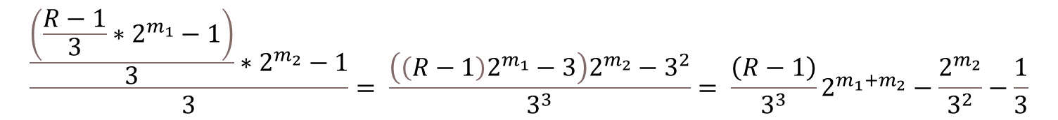
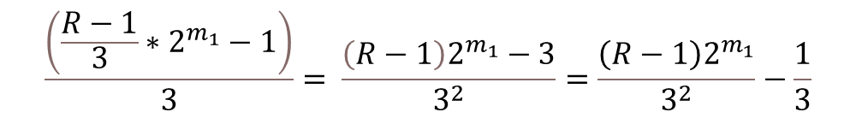
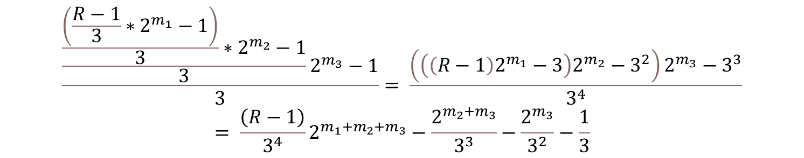
$$\frac{\left(\frac{R−1}{3}∗2^{m_{1}}−1\right)}{3}= \frac{\left(R−1\right)2^{m_{1}}−3}{3^{2}}=\frac{\left(R−1\right)2^{m_{1}}}{3^{2}}−\frac{1}{3}$$
$$\frac{\frac{\left(\frac{R−1}{3}∗2^{m_{1}}−1\right)}{3}∗2^{m_{2}}−1}{3}= \frac{\left(\left(R−1\right)2^{m_{1}}−3\right)2^{m_{2}}−3^{2}}{3^{3}}= \frac{\left(R−1\right)}{3^{3}}2^{m_{1}+m_{2}}−\frac{2^{m_{2}}}{3^{2}}−\frac{1}{3}$$
$$\frac{\frac{\frac{\left(\frac{R−1}{3}∗2^{m_{1}}−1\right)}{3}∗2^{m_{2}}−1}{3}2^{m_{3}}−1}{3}= \frac{\left(\left(\left(R−1\right)2^{m_{1}}−3\right)2^{m_{2}}−3^{2}\right)2^{m_{3}}−3^{3}}{3^{4}}= \frac{\left(R−1\right)}{3^{4}}2^{m_{1}+m_{2}+m_{3}}−\frac{2^{m_{2}+m_{3}}}{3^{3}}−\frac{2^{m_{3}}}{3^{2}}−\frac{1}{3}$$

Slide 11
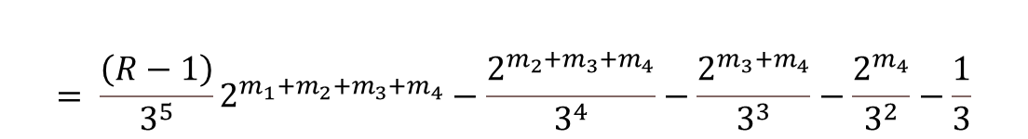

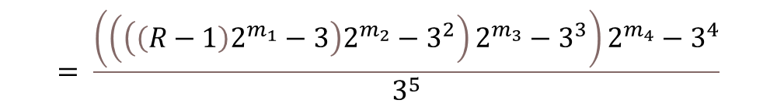
$$\frac{\frac{\frac{\frac{\left(\frac{R−1}{3}∗2^{m_{1}}−1\right)}{3}∗2^{m_{2}}−1}{3}2^{m_{3}}}{3}2^{m_{4}}−1}{3}$$
$$= \frac{\left(\left(\left(\left(R−1\right)2^{m_{1}}−3\right)2^{m_{2}}−3^{2}\right)2^{m_{3}}−3^{3}\right)2^{m_{4}}−3^{4}}{3^{5}}$$
$$= \frac{\left(R−1\right)}{3^{5}}2^{m_{1}+m_{2}+m_{3}+m_{4}}−\frac{2^{{m_{2}+m}_{3}+m_{4}}}{3^{4}}−\frac{2^{m_{3}+m_{4}}}{3^{3}}−\frac{2^{m_{4}}}{3^{2}}−\frac{1}{3}$$

Slide 12
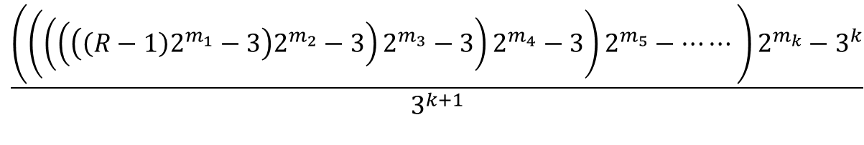
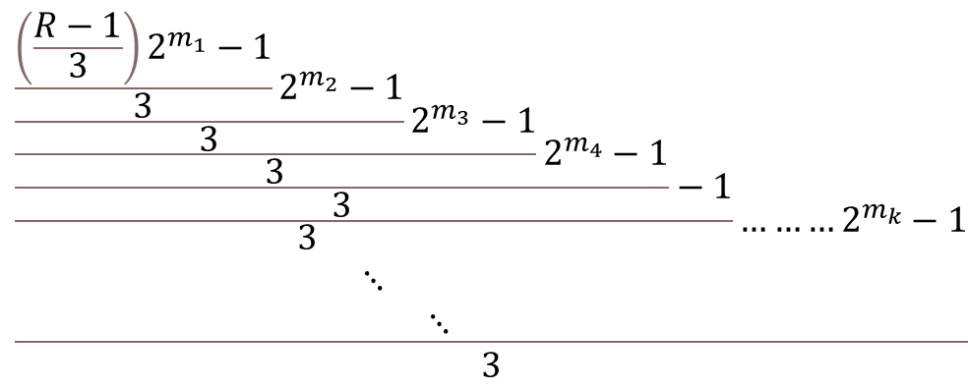

$$\frac{{\frac{\frac{\frac{\frac{\frac{\left(\frac{R−1}{3}\right)2^{m_{1}}−1}{3}2^{m_{2}}−1}{3}2^{m_{3}}−1}{3}2^{m_{4}}−1}{3}−1}{\begin{aligned}&3 \\ & ⋱ \\ & ⋱\end{aligned}}………2}^{m_{k}}−1}{3}$$
$$\frac{\left(\left(\left(\left(\left(\left(R−1\right)2^{m_{1}}−3\right)2^{m_{2}}−3\right)2^{m_{3}}−3\right)2^{m_{4}}−3\right)2^{m_{5}}−⋯⋯\right)2^{m_{k}}−3^{k}}{3^{k+1}}$$
$$=\frac{1}{3^{k+1}}\left(\left(R−1\right)2^{\sum_{i=1}^{k}{m_{i}}}+3∗2^{\sum_{i=2}^{k}{m_{i}}}−\sum_{i=1}^{k}{(3^{i}∗2^{\sum_{j=i}^{k}{m_{j+2}}})}−3^{k}\right)$$

Slide 13
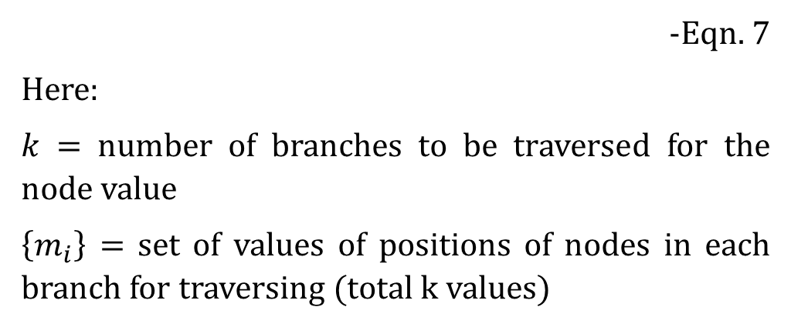
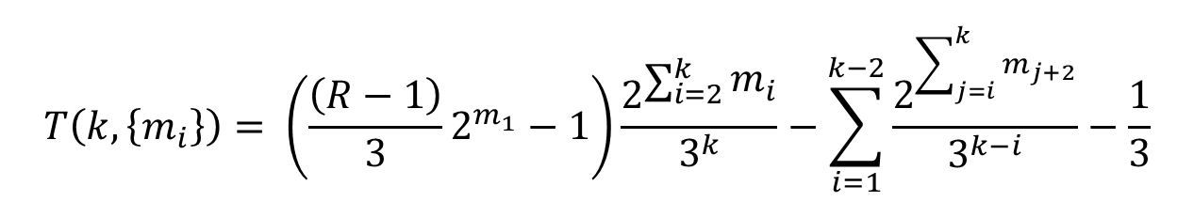
Following is the generalised term:
$$T\left(k, \left\{m_{i}\right\}\right)= \left(\frac{\left(R−1\right)}{3}2^{m_{1}}−1\right)\frac{2^{\sum_{i=2}^{k}{m_{i}}}}{3^{k}}−\sum_{i=1}^{k−2}{\frac{2^{\sum_{j=i}^{k}{m_{j+2}}}}{3^{k−i}}}−\frac{1}{3}$$
-Eqn. 7
Here:
$k$ = number of branches to be traversed for the node value
$\left\{m_{i}\right\}$ = set of values of positions of nodes in each branch for traversing (total k values)

Slide 14
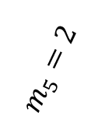
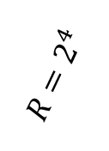
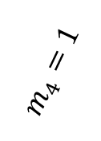

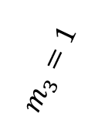
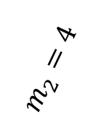
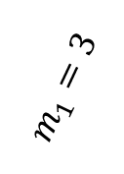
T(5, {3, 2, 1, 1, 2}) = 9
9 | 28 | m5 = 2
 | 14
 | 7 | 22 | m4 = 1
 |  | 11 | 34 | m3 = 1
 |  |  | 17 | 52 | m2 = 2
 |  |  |  | 26
 |  |  |  | 13 | 40 | m1 = 3
 |  |  |  |  | 20
 |  |  |  |  | 10
 |  |  |  |  | 5 | 16 | <-R
 |  |  |  |  |  | 8
 |  |  |  |  |  | 4
 |  |  |  |  |  | 2
 |  |  |  |  |  | 1
$$R=2^{4}$$
$$m_{1}=3$$
$$m_{2}=4$$
$$m_{3}=1$$
$$\frac{\frac{\frac{\frac{\frac{\left(\frac{2^{4}−1}{3}∗2^{3}−1\right)}{3}∗2^{4}−1}{3}2^{1}}{3}2^{1}−1}{3}2^{2}−1 }{3}$$
$$m_{4}=1$$
$$m_{5}=2$$

Slide 15
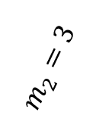
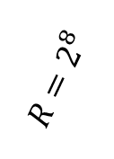
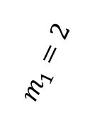
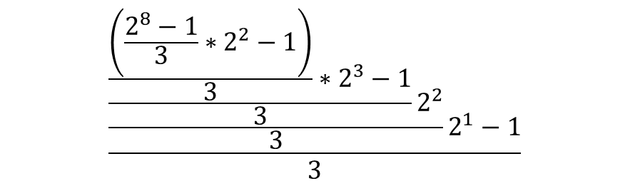
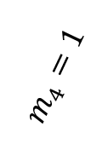
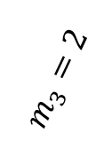
267 | 802 | m4 = 1
 | 401 | 1204 | m3 = 2
 |  | 602
 |  | 301 | 904 | m2 = 3
 |  |  | 452
 |  |  | 226
 |  |  | 113 | 340 | m1 = 2
 |  |  |  | 170
 |  |  |  | 85 | 256 | <-R
 |  |  |  |  | 128
 |  |  |  |  | 64
 |  |  |  |  | 32
 |  |  |  |  | 16
 |  |  |  |  | 8
 |  |  |  |  | 4
 |  |  |  |  | 2
 |  |  |  |  | 1
T(4, {1, 2, 3, 2}) = 267
$${R=2}^{8}$$
$$m_{1}=2$$
$$m_{2}=3$$
$$\frac{\frac{\frac{\frac{\left(\frac{2^{8}−1}{3}∗2^{2}−1\right)}{3}∗2^{3}−1}{3}2^{2}}{3}2^{1}−1}{3}$$
$$m_{3}=2$$
$$m_{4}=1$$

Slide 16
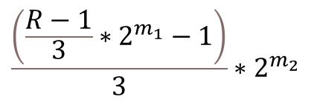
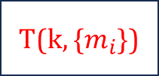
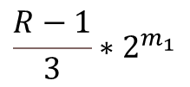

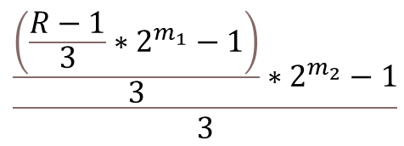
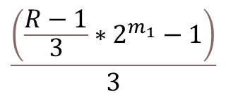
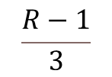
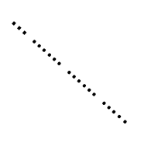
2^{n}
m_{k}
T(k, {$m_{i}$})
$$………………$$
$$\frac{\left(\frac{R−1}{3}∗2^{m_{1}}−1\right)}{3}∗2^{m_{2}}$$
m₆
$…$ …… …… …..
m₅
m₄
$$\frac{R−1}{3}∗2^{m_{1}}$$
m₃
$$\frac{\frac{\left(\frac{R−1}{3}∗2^{m_{1}}−1\right)}{3}∗2^{m_{2}}−1}{3}$$
m₂
m₁
R
$$\frac{\left(\frac{R−1}{3}∗2^{m_{1}}−1\right)}{3}$$
$$\frac{R−1}{3}$$
1

Slide 17
 |  |  |  | 1 |  | 2 |  | 3 |  | 4 |  | 5 |  | 6 |  | 7 |  | 8 |  | 9 |  | 10 |  | 11 |  | 12
8
<-
16 | <- | 5 | <- | 10 | <- | 20 | <- | 40 | <- | 80 | <- | 160 | <- | 320 | <- | 640 | <- | 1280 | <- | 2560 | <- | 5120 | <- | 10240 | <- | 20480 | <-
<-
32
<-
64 | <- | 21 | <- | 42 | <- | 84 | <- | 168 | <- | 336 | <- | 672 | <- | 1344 | <- | 2688 | <- | 5376 | <- | 10752 | <- | 21504 | <- | 43008 | <- | 86016 | <-
<-
128
<-
256 | <- | 85 | <- | 170 | <- | 340 | <- | 680 | <- | 1360 | <- | 2720 | <- | 5440 | <- | 10880 | <- | 21760 | <- | 43520 | <- | 87040 | <- | 174080 | <- | 348160 | <-
<-
512
<-
1024 | <- | 341 | <- | 682 | <- | 1364 | <- | 2728 | <- | 5456 | <- | 10912 | <- | 21824 | <- | 43648 | <- | 87296 | <- | 174592 | <- | 349184 | <- | 698368 | <- | 1396736 | <-
<-
2048
<-
4096 | <- | 1365 | <- | 2730 | <- | 5460 | <- | 10920 | <- | 21840 | <- | 43680 | <- | 87360 | <- | 174720 | <- | 349440 | <- | 698880 | <- | 1397760 | <- | 2795520 | <- | 5591040 | <-
<-
8192
<-
16384 | <- | 5461 | <- | 10922 | <- | 21844 | <- | 43688 | <- | 87376 | <- | 174752 | <- | 349504 | <- | 699008 | <- | 1398016 | <- | 2796032 | <- | 5592064 | <- | 11184128 | <- | 22368256 | <-
<-
32768
<-
+1
+2
+4
+8
+16
+32
+64
+128
+256
+512
+1024
+1
+2
+4
+8
+16
+32
+64
+128
+256
+512
+1024
+1
+2
+4
+8
+16
+32
+64
+128
+256
+512
+1024
+1
+2
+4
+8
+16
+32
+64
+128
+256
+512
+1024
+1
+2
+4
+8
+16
+32
+64
+128
+256
+512
+1024

Slide 18
 |  |  |  | 1 |  | 2 |  | 3 |  | 4 |  | 5 |  | 6 |  | 7 |  | 8 |  | 9 |  | 10 |  | 11 |  | 12
5
<-
10 | <- | 3 | <- | 6 | <- | 12 | <- | 24 | <- | 48 | <- | 96 | <- | 192 | <- | 384 | <- | 768 | <- | 1536 | <- | 3072 | <- | 6144 | <- | 12288 | <-
<-
20
<-
40 | <- | 13 | <- | 26 | <- | 52 | <- | 104 | <- | 208 | <- | 416 | <- | 832 | <- | 1664 | <- | 3328 | <- | 6656 | <- | 13312 | <- | 26624 | <- | 53248 | <-
<-
80
<-
160 | <- | 53 | <- | 106 | <- | 212 | <- | 424 | <- | 848 | <- | 1696 | <- | 3392 | <- | 6784 | <- | 13568 | <- | 27136 | <- | 54272 | <- | 108544 | <- | 217088 | <-
<-
320
<-
640 | <- | 213 | <- | 426 | <- | 852 | <- | 1704 | <- | 3408 | <- | 6816 | <- | 13632 | <- | 27264 | <- | 54528 | <- | 109056 | <- | 218112 | <- | 436224 | <- | 872448 | <-
<-
1280
<-
2560 | <- | 853 | <- | 1706 | <- | 3412 | <- | 6824 | <- | 13648 | <- | 27296 | <- | 54592 | <- | 109184 | <- | 218368 | <- | 436736 | <- | 873472 | <- | 1746944 | <- | 3493888 | <-
<-
5120
<-
10240 | <- | 3413 | <- | 6826 | <- | 13652 | <- | 27304 | <- | 54608 | <- | 109216 | <- | 218432 | <- | 436864 | <- | 873728 | <- | 1747456 | <- | 3494912 | <- | 6989824 | <- | 13979648 | <-
<-
20480
<-
+1
+2
+4
+8
+16
+32
+64
+128
+256
+512
+1024
+1
+2
+4
+8
+16
+32
+64
+128
+256
+512
+1024
+1
+2
+4
+8
+16
+32
+64
+128
+256
+512
+1024
+1
+2
+4
+8
+16
+32
+64
+128
+256
+512
+1024
+1
+2
+4
+8
+16
+32
+64
+128
+256
+512
+1024

Slide 19
 |  |  |  | 1 |  | 2 |  | 3 |  | 4 |  | 5 |  | 6 |  | 7 |  | 8 |  | 9 |  | 10 |  | 11 |  | 12
8
<-
16 | <- | 5 | <- | 10 | <- | 20 | <- | 40 | <- | 80 | <- | 160 | <- | 320 | <- | 640 | <- | 1280 | <- | 2560 | <- | 5120 | <- | 10240 | <- | 20480 | <-
<-
32
<-
64 | <- | 21 | <- | 42 | <- | 84 | <- | 168 | <- | 336 | <- | 672 | <- | 1344 | <- | 2688 | <- | 5376 | <- | 10752 | <- | 21504 | <- | 43008 | <- | 86016 | <-
<-
128
<-
256 | <- | 85 | <- | 170 | <- | 340 | <- | 680 | <- | 1360 | <- | 2720 | <- | 5440 | <- | 10880 | <- | 21760 | <- | 43520 | <- | 87040 | <- | 174080 | <- | 348160 | <-
<-
512
<-
1024 | <- | 341 | <- | 682 | <- | 1364 | <- | 2728 | <- | 5456 | <- | 10912 | <- | 21824 | <- | 43648 | <- | 87296 | <- | 174592 | <- | 349184 | <- | 698368 | <- | 1396736 | <-
<-
2048
<-
4096 | <- | 1365 | <- | 2730 | <- | 5460 | <- | 10920 | <- | 21840 | <- | 43680 | <- | 87360 | <- | 174720 | <- | 349440 | <- | 698880 | <- | 1397760 | <- | 2795520 | <- | 5591040 | <-
<-
8192
<-
16384 | <- | 5461 | <- | 10922 | <- | 21844 | <- | 43688 | <- | 87376 | <- | 174752 | <- | 349504 | <- | 699008 | <- | 1398016 | <- | 2796032 | <- | 5592064 | <- | 11184128 | <- | 22368256 | <-
<-
32768
<-
4x+1
4x+2
4x+4
4x+8
4x+16
4x+32
4x+64
4x+128
4x+256
4x+512
4x+1024
4x+2048
4x+4096
4x+1
4x+2
4x+4
4x+8
4x+16
4x+32
4x+64
4x+128
4x+256
4x+512
4x+1024
4x+2048
4x+4096
4x+1
4x+2
4x+4
4x+8
4x+16
4x+32
4x+64
4x+128
4x+256
4x+512
4x+1024
4x+2048
4x+4096
4x+1
4x+2
4x+4
4x+8
4x+16
4x+32
4x+64
4x+128
4x+256
4x+512
4x+1024
4x+2048
4x+4096
4x+1
4x+2
4x+4
4x+8
4x+16
4x+32
4x+64
4x+128
4x+256
4x+512
4x+1024
4x+2048
4x+4096

Slide 20
 |  |  |  | 1 |  | 2 |  | 3 |  | 4 |  | 5 |  | 6 |  | 7 |  | 8 |  | 9 |  | 10 |  | 11 |  | 12
5
<-
10 | <- | 3 | <- | 6 | <- | 12 | <- | 24 | <- | 48 | <- | 96 | <- | 192 | <- | 384 | <- | 768 | <- | 1536 | <- | 3072 | <- | 6144 | <- | 12288 | <-
<-
20
<-
40 | <- | 13 | <- | 26 | <- | 52 | <- | 104 | <- | 208 | <- | 416 | <- | 832 | <- | 1664 | <- | 3328 | <- | 6656 | <- | 13312 | <- | 26624 | <- | 53248 | <-
<-
80
<-
160 | <- | 53 | <- | 106 | <- | 212 | <- | 424 | <- | 848 | <- | 1696 | <- | 3392 | <- | 6784 | <- | 13568 | <- | 27136 | <- | 54272 | <- | 108544 | <- | 217088 | <-
<-
320
<-
640 | <- | 213 | <- | 426 | <- | 852 | <- | 1704 | <- | 3408 | <- | 6816 | <- | 13632 | <- | 27264 | <- | 54528 | <- | 109056 | <- | 218112 | <- | 436224 | <- | 872448 | <-
<-
1280
<-
2560 | <- | 853 | <- | 1706 | <- | 3412 | <- | 6824 | <- | 13648 | <- | 27296 | <- | 54592 | <- | 109184 | <- | 218368 | <- | 436736 | <- | 873472 | <- | 1746944 | <- | 3493888 | <-
<-
5120
<-
10240 | <- | 3413 | <- | 6826 | <- | 13652 | <- | 27304 | <- | 54608 | <- | 109216 | <- | 218432 | <- | 436864 | <- | 873728 | <- | 1747456 | <- | 3494912 | <- | 6989824 | <- | 13979648 | <-
<-
20480
<-
4x+1
4x+2
4x+4
4x+8
4x+16
4x+32
4x+64
4x+128
4x+256
4x+512
4x+1024
4x+2048
4x+4096
4x+1
4x+2
4x+4
4x+8
4x+16
4x+32
4x+64
4x+128
4x+256
4x+512
4x+1024
4x+2048
4x+4096
4x+1
4x+2
4x+4
4x+8
4x+16
4x+32
4x+64
4x+128
4x+256
4x+512
4x+1024
4x+2048
4x+4096
4x+1
4x+2
4x+4
4x+8
4x+16
4x+32
4x+64
4x+128
4x+256
4x+512
4x+1024
4x+2048
4x+4096
4x+1
4x+2
4x+4
4x+8
4x+16
4x+32
4x+64
4x+128
4x+256
4x+512
4x+1024
4x+2048
4x+4096

